Slide 1
HEAP BASED BUFFER OVERFLOW
CVE-2021-3156
ENPM-691
Presenters: Anirudh Pratap Singh
Saran Raj Venugopal
Supraja Koneru

Slide 2
WHAT IS HEAP?
The heap is a memory space used by programming languages to store the global variables by default
These variables are allocated using malloc() and calloc() functions and resize using realloc() function, which are inbuilt functions of C.
It supports Dynamic memory allocation.

Slide 3
WHAT IS HEAP OVERFLOW?
Heap overflow is a memory corruption overflow that occurs on the heap.
When a block of memory is assigned to the heap , data is written to it without any bound checking causing a buffer overflow in the heap data field.

Slide 4
SHELL MODE
sudo command helps us to run the user as a root user
sudo – s and sudo – i makes the user to run a new shell as root

Slide 5
SUDO EDIT
sudo sudoedit
Runs a command edits a file
sudo sets MODE_RUN sudoedit sets MODE_EDIT
sudo can be run with a flag –e
Sets MODE_EDIT
Unsets MODE_RUN

Slide 6
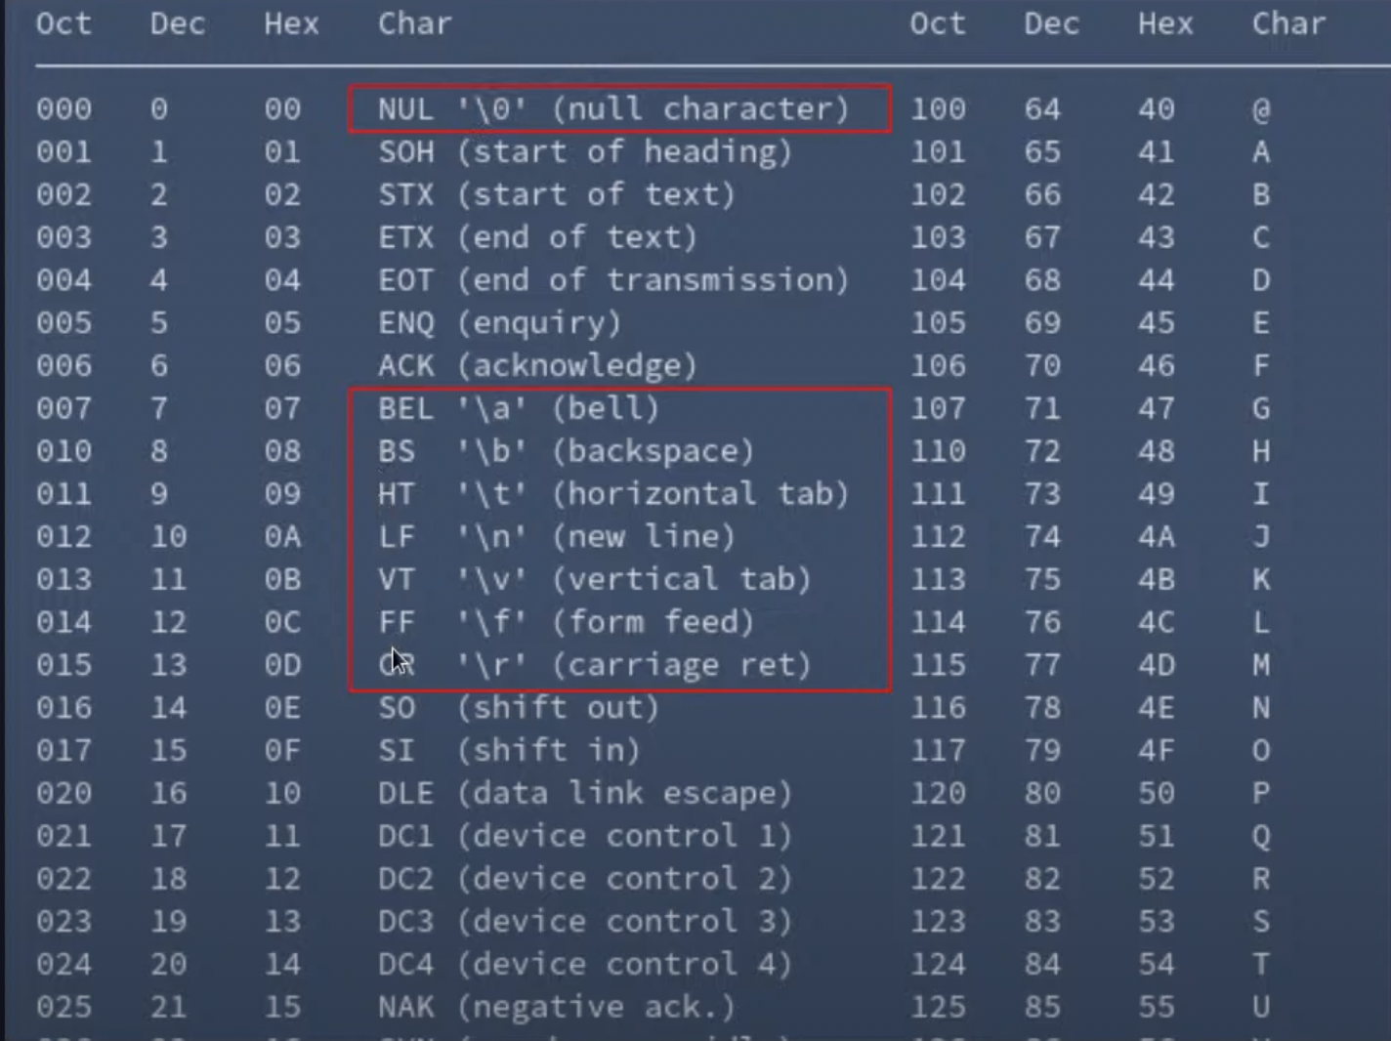
SPECIAL CHARACTERS
Certain characters are escaped by the “\”

Slide 7
SUDO CODE - 1
In first part of the code, different flags are checked.
sudo code should be used without -e flag.
Enable MODE_SHELL by using sudo –i or –s flag.
Code line 587 to 595 it filters out any special character that we can exploit. So this code should not be executed before exploitation.
The highlighted comment of "quote potential meta characters" searches for potential meta characters, and if it finds any that don't fit in the code (line 590), it increments and moves on.
The code from lines 587 to 595 should not be executed, and when we design our exploit, we must find a way for the -s flag. MODE_RUN is to be set but not both; if both are set, our command line arguments will be filtered.

Slide 8
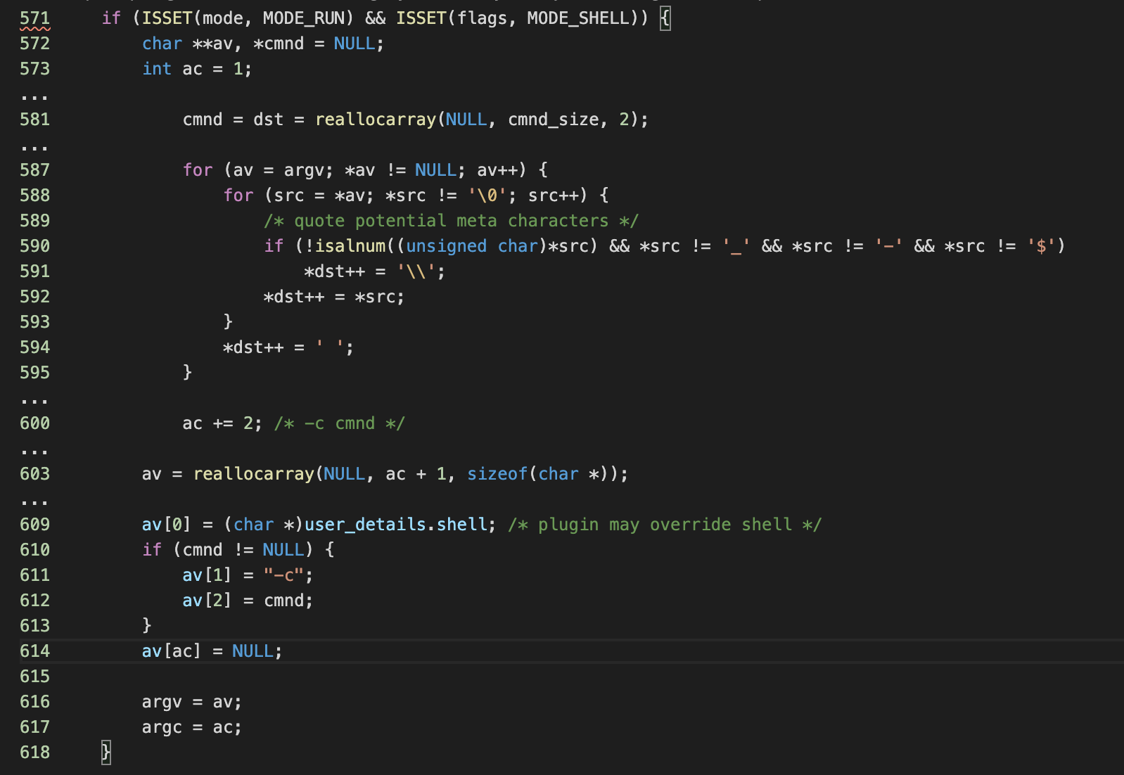
SUDO CODE - 1

Slide 9
SUDO CODE - 2
In the sudo code - 2, make sure that MODE_SHELL is enabled as well as MODE_EDIT.
This code checks length of a buffer by 2D array of argv and array of character arrays which represents strings in C code.
If backslash escapes a character other than the space it is a special character or a byte.
It is a powerful bug because it skips a character following a ‘’\”.
This can be seen in the line 866 in the SUDO CODE 2.

Slide 10
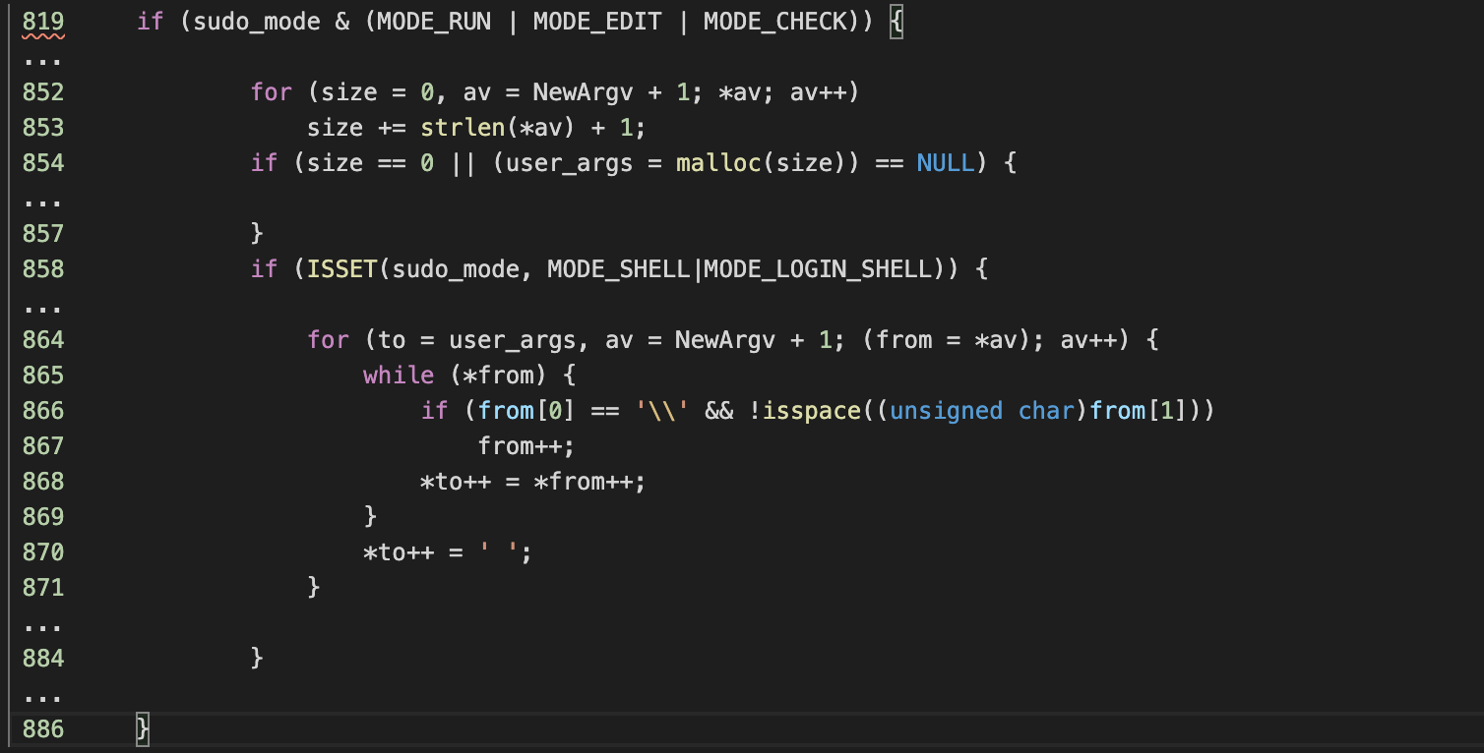
SUDO CODE - 2

Slide 11
CONTROLING THE OVERFLOW
envp is allocated above argv
agrv size can be controlled
End our arguments with “\”
Copy

Slide 12
REACHING VULNERBALE CODEPATHS
MODE_EDIT and MODE_SHELL but not MODE_RUN
sudo MODE_RUN
sudo-s MODE_RUN and MODE_SHELL
sudo-e MODE_RUN and MODE_EDIT
sudoedit MODE_EDIT

Slide 13
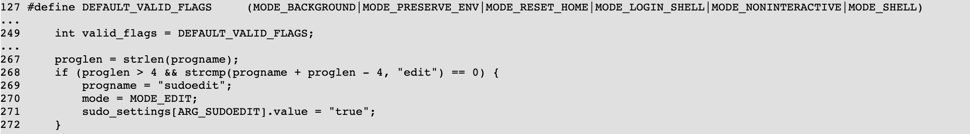
WHAT’S IN A NAME
Sudoedit is actually just sudo in disguise
Automatically sets MODE_EDIT
Does not set MODE_RUN

Slide 14
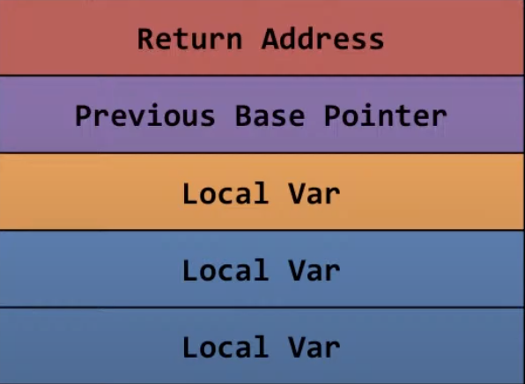
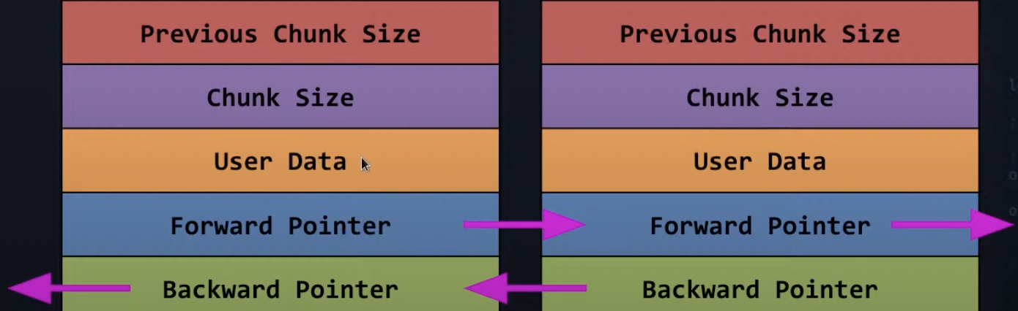
HEAP VANDALISM
HEAP
STACK

Slide 15
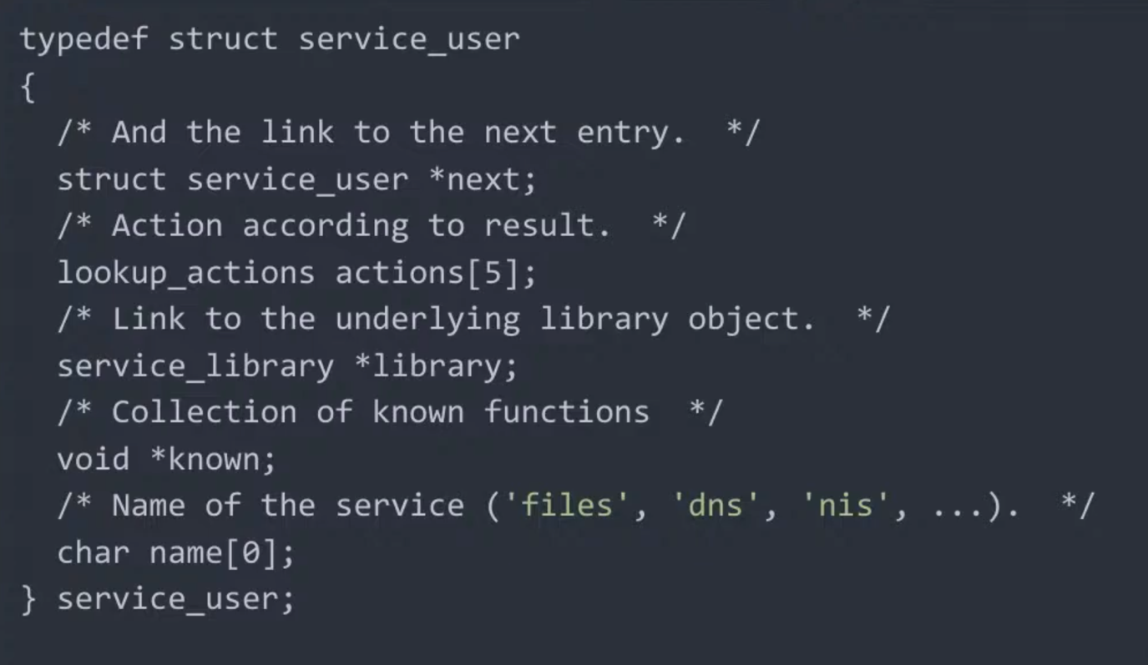
NSS_LOAD_LIBRARY

Slide 16
THE EXPLOIT (EXPLANATION)
Use C language as well for exploit.
This exploit is trying to overflow into some of the special structs in the Heap allocations.
Most importantly we overflow into the nss_load_library which is responsible for calling any of the dynamic libraries.
This load library has a struct in the heap which is called service_user.
Then we start a shell with environment variables like setuid and seteuid and few more as zero (root).

Slide 17
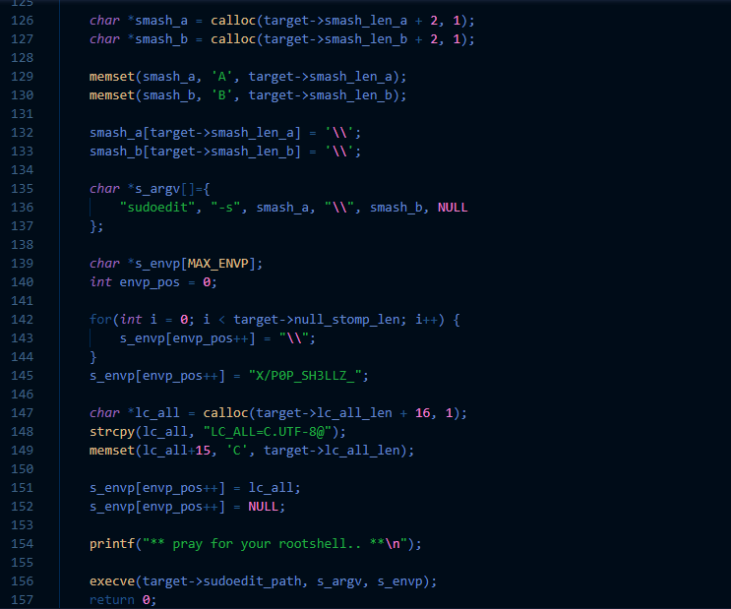
THE EXPLOIT

Slide 18
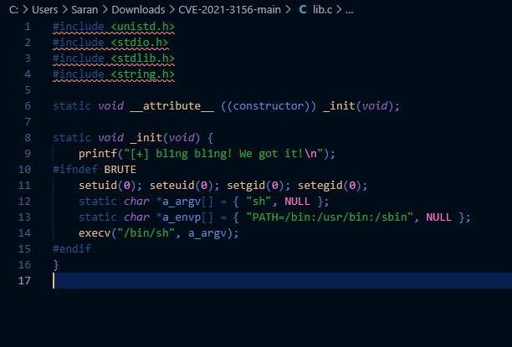
EXPLOIT – SHARED FILE CREATION

Slide 19
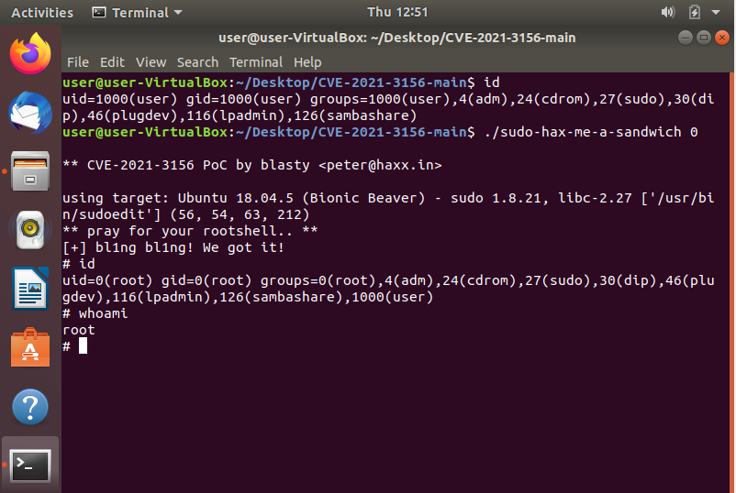
EXPLOIT – IN ACTION (DEMO)

Slide 20
SUDO EXPLOITABLE VERSIONS
VERSIONS:
LEGACY VERSION: 1.8.2 TO 1.8.31P2
STABLE VERSION : 1.9.0 TO 1.9.5P1
In the above versions, when the command
sudoedit -s `\' perl -e 'print "A" x 65536` is used we get a segmentation fault error

Slide 21
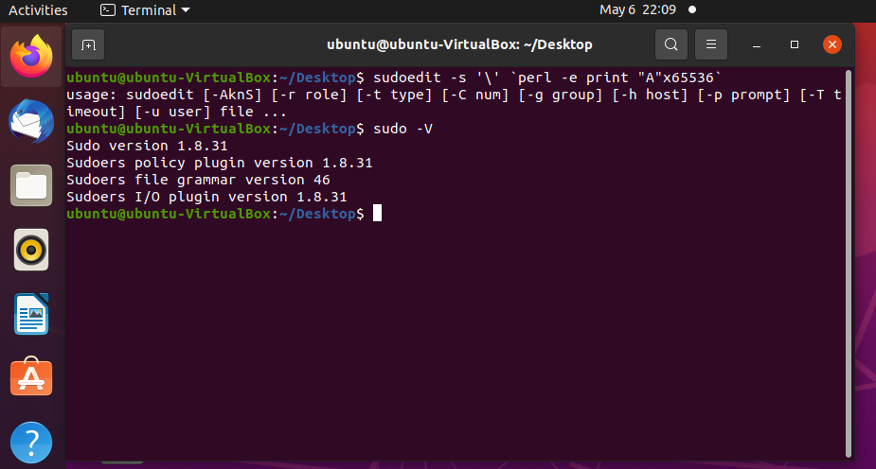
SUDO FIX – THE PROOF

Slide 22
REFERENCES
https://azeria-labs.com/heap-exploitation-part-1-understanding-the-glibc-heap-implementation/
https://blog.qualys.com/vulnerabilities-research/2021/01/26/cve-2021-3156-heap-based-buffer-overflow-in-sudo-baron-samedit
https://www.openwall.com/lists/oss-security/2021/01/26/3
https://nvd.nist.gov/vuln/detail/CVE-2021-3156
Exploit - https://github.com/blasty/CVE-2021-3156

